Slide 1
Microsoft Certifications for Developers
Hannah Gavisk

Slide 2
Microsoft Certified Professional
Pass one qualifying MCP exam (many options!)
MCP-qualifying exams include all of the exams required for these certifications:
MCSA – Microsoft Certified Solutions Associate
MCSE – Microsoft Certified Solutions Expert
MCSD – Microsoft Certified Solutions Developer
Microsoft Specialist
MTA & MOS exams do not qualify for MCP certification
https://www.microsoft.com/en-us/learning/microsoft-certified-professional.aspx

Slide 3
MCSD Microsoft Certified Solutions Developer
Windows Store Apps
Web Applications
SharePoint Applications
Azure Solutions Architect
Application Lifecycle Management
Universal Windows Platform

Slide 4
MCSD Exams by Track
MCSD
Microsoft Certified Solutions Developer
Windows Store Apps Using HTML5
Windows Store Apps Using
C#
Web Applications
SharePoint Applications
Azure Solutions Architect
Application Lifecycle Management
Universal Windows Platform
Programming in HTML5 with JavaScript and CSS3
Essentials of Developing Windows Store Apps Using HTML5 and JavaScript
Advanced Windows Store App Development Using HTML5 and JavaScript
Programming in C#
Essentials of Developing Windows Store Apps Using C#
Advanced Windows Store App Development Using C#
Programming in HTML5 with JavaScript and CSS3
Developing ASP.NET MVC Web Applications
Developing Microsoft Azure and Web Services
Programming in HTML5 with JavaScript and CSS3
Developing ASP.NET MVC Web Applications
Developing SharePoint Server 2013 Core Solutions
Developing SharePoint Server 2013 Advanced Solutions
Developing Microsoft Azure Solutions
Implementing Microsoft Azure Infrastructure Solutions
Architecting Microsoft Azure Solutions
Administering Microsoft Visual Studio Team Foundation Server
Software Testing with Visual Studio
Delivering Continuous Value with Visual Studio Application Lifecycle Management
Programming in C#
Universal Windows Platform – App Architecture and UX/UI
Universal Windows Platform – App Data, Services, and Coding Patterns

Slide 5
Pricing Details
Most exams are $150
As of April 25, 2016, Microsoft announced that exam prices would be changing after June 30th.
When purchasing exam, check voucher expiration
Be prepared to buy a practice exam
Transcender $140 for download & 90-day web access
Measure Up $119 for download
Check how long you will have access to the practice exam
Recertification exam is required every 2 years for the 4-letter certifications

Slide 6
Is it worth it?
…it depends.
Just like a college degree, a certification’s actual value and it’s perceived value depend on the situation, and on who you ask.

Slide 7
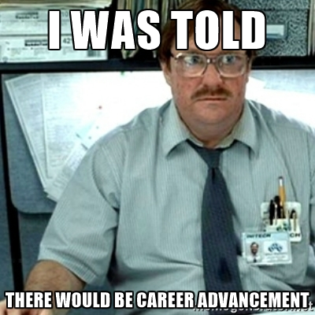
Benefits to your Career

Slide 8
Benefits to your Career
Shows commitment to growth & learning
Value is easily translated & transferable
Non-technical clients & hiring managers can interpret skill level
Early career benefits
Prove your competencies even with limited examples of experience
Mid/Late career benefits
Prove your competencies in current technology

Slide 9
Employer Benefits Microsoft Partner Network
Competency Partners
https://partner.microsoft.com/en-US/membership/competencies
Competency Benefits & Requirements
https://partner.microsoft.com/en-us/membership/application-development-competency

Slide 10

Study Strategy

Slide 11
Study Strategy
Identify what you need to know
Prioritize - put the most energy into studying topics that will be on the exam
Use a variety of study materials
Some materials will cover info left out by others
Get hands-on experience – build stuff!
Use code examples from exam study guides, MSDN, or Pluralsight
Study with others
Motivation & encouragement
Explain concepts to each other
Can share practice projects
Make time to study
Block off time to study
Arrange to be away from distractions
Identify up-front how much time you plan to spend studying

Slide 12
Study Materials
Practice exam
Study guide/book
Pluralsight
Microsoft Virtual Academy
“All learning materials related to exams, including Microsoft training and Microsoft Press resources, are developed independently of exam content, because the exams are intended to assess competence when using the technology, not the effectiveness of training materials or learning. ” –Microsoft Exam FAQ

Slide 13
Practice Exam
Providers include Transcender, MeasureUp and others
The Good
Tailored to imitate actual exam content & difficulty
Identify what you need to know
Gauge readiness, identify trouble areas
SUPER HELPFUL – Transcender practice exams provide reference links on each question & act as additional study resource
The Bad
Practice exam format might not closely match actual exam
Interface on practice exam may be more outdated
Actual exam may have more up-to-date UI, such as drag/drop interactive questions

Slide 14
Practice Exam Transcender Question Examples
https://www.transcender.com/

Slide 15
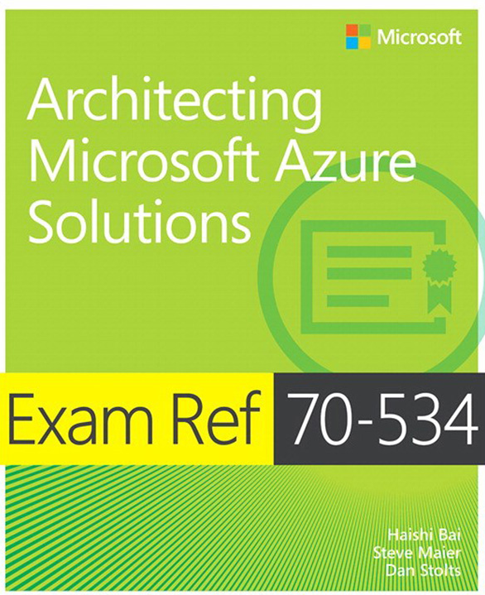
Study Guides from Microsoft Press
Microsoft Press Exam Ref books
Available in print & electronic formats
The Good
Specifically covers topics that will be on exam
Code examples are formatted similar to practice & actual exam
Use examples to build hands-on practice projects
The Bad
Dry, boring material
Code examples can be strange
Content is NOT arranged in an instructive way. Not suitable for learning for the first time.
https://ptgmedia.pearsoncmg.com/images/9780735676824/samplepages/9780735676824.pdf

Slide 16
Pluralsight
Learning Paths
Pluralsight offers “Learning Paths” for most exams
The Good
Best way to get up to speed if you are NOT very familiar with the subject matter
Can download the code for some videos to follow along
The Bad
Usually 50+ hours of video
Videos are usually NOT created with the exam in mind
Learning path consists of pre-existing videos that relate to the exam topics
More info than necessary
Examples may not match test format
How to use Pluralsight for studying
Identify specific topics you need to study
Don’t watch the entire video – just the module you need
https://www.pluralsight.com/blog/software-development/asp-net-mvc-microsoft-exam-70-486

Slide 17
Other Resources
Microsoft Virtual Academy https://mva.microsoft.com/
Certification Community https://borntolearn.mslearn.net/certification/

Slide 18
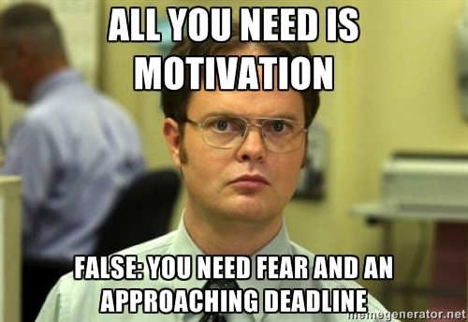
PROTIP:

Slide 19

PROTIP:
schedule your exam!

Slide 20
Exam Day
Be early – like really early
Know where to park
Know which building & room number
The proctor has earplugs if you need them
Manage your time during the test
http://springfield.otc.edu/maps-and-directions/

Slide 21
Exam Details
What score do I need to pass?
https://www.microsoft.com/en-us/learning/certification-exam-policies.aspx#faqscoring-11
“All MCSA, MCSE, and MSCD exams are scaled such that the passing score is 700.”
“The number of items that you have to answer correctly varies depending on the difficulty of the questions delivered when you take the exam”
Question types: https://www.microsoft.com/en-us/learning/certification-exams.aspx#types
Multiple choice
Matching
Short answer
Case Studies
Number of questions varies, but 40-60 is typical
Time limit ranges from 45-150 minutes, depending on exam

Slide 22
Special Programs through Microsoft
Re-taking an exam
Second Shot promotion usually runs July – January
Current promotion is Booster Pack
https://www.microsoft.com/en-us/learning/offers.aspx
Student pricing
https://www.microsoft.com/en-us/learning/certification-exam-policies.aspx#policies-2
Student discount is typically 15% - 20% off

Slide 23
Questions?

